Slide 1

Linear Arrays
Representation & Traversal
Insertion
Deletion
Linear Search
Bubble Sort
Binary Search

Slide 2
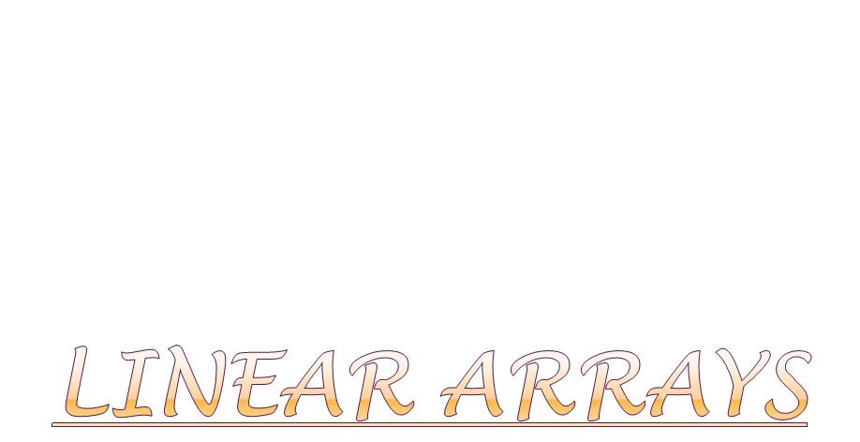

Slide 3

A linear array is a list a finite number n of homogeneous data elements such that:
The elements of the array are referenced respectively by an index set consisting of n consecutive numbers
The elements of the array are stored respectively in successive memory locations
The number n of elements is called the length or size of the array.
Length= UB-LB+1

Slide 4
UB -> Upper Bound(largest index)
LB -> Lower Bound(smallest index)
Three items of information are essential for declaring arrays:
the name of the array
the data type of the array
the index set of the array

Slide 5
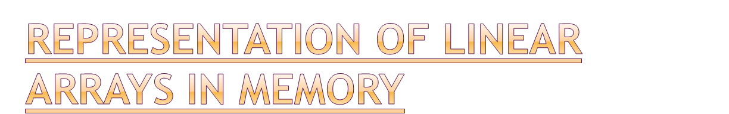
Let LA be a linear array in the memory of the computer.
LOC(LA[K])=address of the element LA[K] of
the array LA
1000
1001
1002
1003
Computer
Memory

Slide 6
The computer does not need to keep track of the address of every element of LA, but needs to keep track only of the address of the element of LA, denoted by
Base(LA)
and called the base address of LA. Using this address Base(LA), the computer calculates the address of any element of LA by the following formula:
LOC(LA[K])=Base(LA)+ w(K-Lower Bound)
where w -> number of words per memory cell for the array LA.

Slide 7
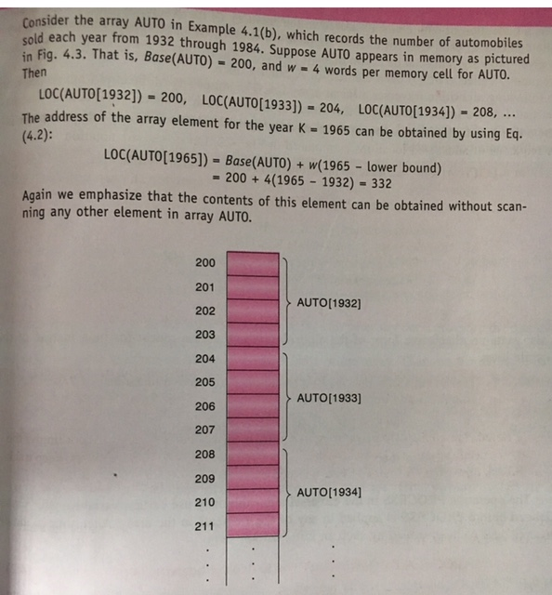

Slide 8


Slide 9

Let A be a collection of data elements stored in memory of the computer. Suppose we want to print the contents of each element A or suppose we want to count the number of elements of A with a given property. This can be accomplished by traversing and processing each element of A exactly once.

Slide 10
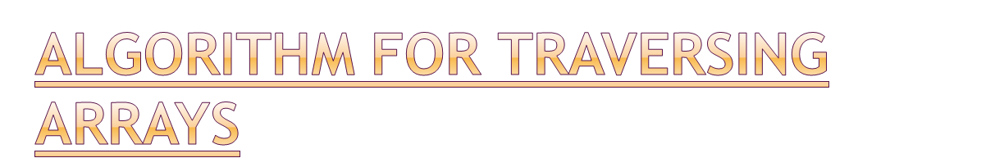
Here LA is a linear array with lower bound LB and upper bound UB.
1. Set K:=LB
2. Repeat steps 3 and 4 while K<=UB
3. Apply process to LA[K]
4. Set K:=K+1
[End of step2 loop]
5. Exit

Slide 11
Here LA is a linear array with lower bound LB and upper bound UB.
1. Repeat for K=LB to UB
Apply PROCESS to LA[K]
[End of loop]
2. Exit

Slide 12

INSERT(LA,N,K,ITEM)
Let LA is a linear array with N elements and K is a positive integer such that K<=N. This algorithm inserts an element ITEM into the Kth position in LA.
1. Set J:=N
2. Repeat steps 3 & 4 while J>=LOC
3. Set LA[J+1]:=LA[J]
4. Set J:=J-1
[End of Step2 loop]
5. Set LA[LOC]:=ITEM
6. Set N:=N+1
7. Exit

Slide 13

Deleting from linear Array DELETE(LA,N,K,ITEM)
Let LA is a linear array with N elements and K is a positive integer such that K<=N. This algorithm deletes the kth element from LA.
      1. Set Item=LA[k]
      2.Repeat for j=k to n-1
      [Move j+1st element upward] Set LA[j]=LA[j+1]
      [End of loop]
      3. Set J=J+1
      4. [Reset n] Set N=N-1
      5. Exit

Slide 14

A linear array DATA with N elements and specific information ITEM are given. This algo finds the location LOC of ITEM in the array or sets LOC=0
1.[Initialize] Set k:=1 and LOC:=0
2. Repeat steps 3 and 4 while LOC=0 and k<=N
3. If ITEM= DATA[K], then set LOC:=k.
4. Set k:=k+1 [Increments Counter]
[end of step 2 loop]
5. If LOC=0 , then
write: ITEM not found in array
Else
write: LOC is the location of ITEM
[end if]
6 Exit

Slide 15

  Algo: Bubble(DATA,N) Here DATA is an Array with N elements.
  1.Repeat Steps 2 and 3 for i=1 to N-1
  2. Set J=1[Initializes pass variable j ]
  3. Repeat while J<=N-i [Executes pass]
  a) if DATA[J]>DATA[J+1] then
  Interchange DATA[J] and DATA[J+1].
  [End of if structure]
  b) Set J:=J+1.
  [End of inner loop]
  [End of outer loop]
  4. Exit

Slide 16
Example: 30,55,20,82,63,19,13,57
PASS1:
1) Compare 30<55 No change.
2) Compare 55<20(interchange) 30,20,55,82,63,19,13,57
3) Compare 55<82 no change.
4) Compare 82<63 (interchange) 30,20,55,63,82,19,13,57
5) Compare 82<19(interchange) 30,20,55,63,19,82,13,57
6) Compare 82<13 (interchange) 30,20,55,63,19,13,82,57
7)Compare 82<57(interchange) 30,20,55,63,19,13,57,82
At pass 1 82 reached it correct Nth position.( N-1 Comparison)

Slide 17
30,20,55,63,19,13,57,82
Pass 2:
Compare 30<20( Interchange) 20,30,55,63,19,13,57,82
Compare 30<55 No change
Compare 55<63 no change
Compare 63<19 (interchange)30,20,55,19,63,13,57,82
5) Compare 63<13 (interchange) 30,20,55,19,13,63,57,82
Compare 63<57(interchange) 30,20,55,19,13,57,63,82
At pass2 2nd largest no reach N-1 position(N-2 Comparison)
The same procedure will repeat till n-1 no of passes and after n-1 pass the data will be sorted.

Slide 18
Complexity of bubble sort:
  f(n)=(n-1)+(n-2)+….+2+1= n(n-1)/2= n*n/2+O(n)=O(n*n).

Slide 19
Binary Search: Algorithm(this algorithm finds the location of item in data or sets loc=null)
      1) [Initialize segment variables]
      Set BEG:=LB,END=UB and mid=INT((BEG+END)/2)
      2) Repeat Steps 3 and 4 while BEG<=END and DATA[MID] != Item.
      3) If Item < DATA[MID] then
      Set End :=Mid-1
      Else
      Set Beg:=Mid+1
      [End of Step 2 loop]
      4) Set MID := INT((BEG+END)/2)
      [End of if structure]
      5)If DATA[MID] =Item then
      Set LOC:= MID
      Else
      Set LOC:=NULL
      6) EXIT

